Slide 1


Homework 3
Due on 10/3/2018 for class meeting on Mon & Wed
Due on 10/4/2018 for class meeting on Tue & Thu
v₀
1. A small ball on an incline surface with angle θ is thrown with velocity v_{o} at angle vertical to the incline surface, as shown in Fig.1. What is the distance d it can reach? And how long t_{f} has it been in the air?
┐
d
2. You are playing a video game to fire an “angry bird” to attack a pirate ship moving cross the river (see figure). The ship has constant velocity. The “angry bird” is fired with velocity v_{B} at an angle θ=45⁰ above the surface of the river and an angle α relative to the river bank. The initial distant between the ship and angry bird is 64m. (Let g = 10 m/s₂ )
(a) Ignore the river current and air friction and the “angry bird” is fired at the same time as the ship starts. Find the magnitude of the velocity v_{B} and the angle α such that the “angry bird” will hit the ship. How much time it takes?
If the speed of the river current is 8m/s along +x direction and you still fire the “angry bird” at same angle α as in part (a) but different θ. What are the velocity v_{B} and the angle
θ for hitting the ship? What is the distance between the initial firing position and the position where “angry bird” hit the ship?

Slide 2
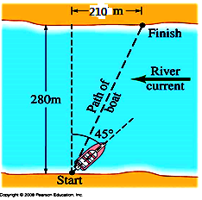
3. A boat must cross a 280-m-wide river and arrive at a point 210 m upstream from where it starts (Fig. 6). The speed of the river is 3 m/s. To do so, the pilot must head the boat at a 45º upstream angle. What is the speed of the boat v relative to the bank (in unit of m/s) ?

Slide 3
(1)
y
v₀
Equ. (1) ➔
--- (3)
┐
x
1
d
Equ. (3) 帶入 equ. (2)➔
--- (1)
--- (2)
There are two equations and two variables, t_{f} and d. Solvable.

Slide 4

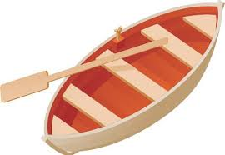




基本物理條件分析:
Ship:
Angry bird:
$$\overset{⃑}{v_{B}}$$
$$v_{B}cos45°$$
$$\overset{⃑}{v_{s}}$$
45˚
$$α$$
d=64m
Angry bird hit the ship: 擊中條件
計算過程:

Slide 5



基本物理條件分析:
Angry bird:
Ship:
θ
37˚
d=64m
計算過程:
Angry bird hit the ship: 擊中條件

Slide 6
210 m
70 m
C
β
B
γ
280 m
396 m
χ
α
A
Velocity
distance
and

